Slide 1
British Airways
Predictive Modelling Results

Slide 2


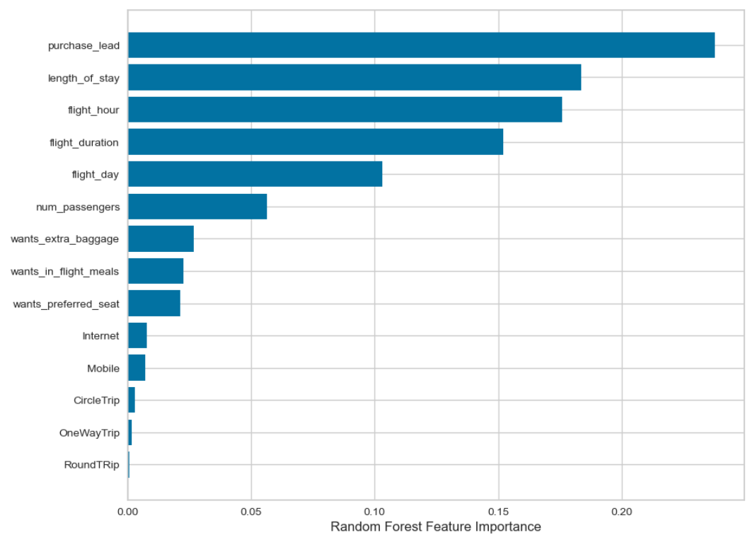

Accuracy and Imbalanced Data: Accuracy: 61% Higher accuracy might seem appealing, but we need to dig deeper to understand the true performance.
Precision and True Positives: Precision: 60% This metric tells us about the accuracy of positive predictions. 60% of predicted completed bookings are actually successful bookings.
Recall and Identifying Success: Recall: 59% This metric highlights how well we identify true successful bookings. There's a 59% chance of capturing actual successful bookings.
The most influential variable impacting successful flight bookings was identified as 'Purchase Lead Time. This refers to the duration between the booking purchase and the actual departure.
Flight-related variables, such as flight time and duration, emerged as significant factors influencing successful flight bookings. Customers' booking origin, on the other hand, did not demonstrate a substantial impact on booking outcomes.
Key Features Driving Successful Flight Bookings

